Slide 1
Technical Presentation
“Give a short presentation (maximum 15 minutes) about a technical topic from your own work”
Jonathan Corcutt

Slide 2
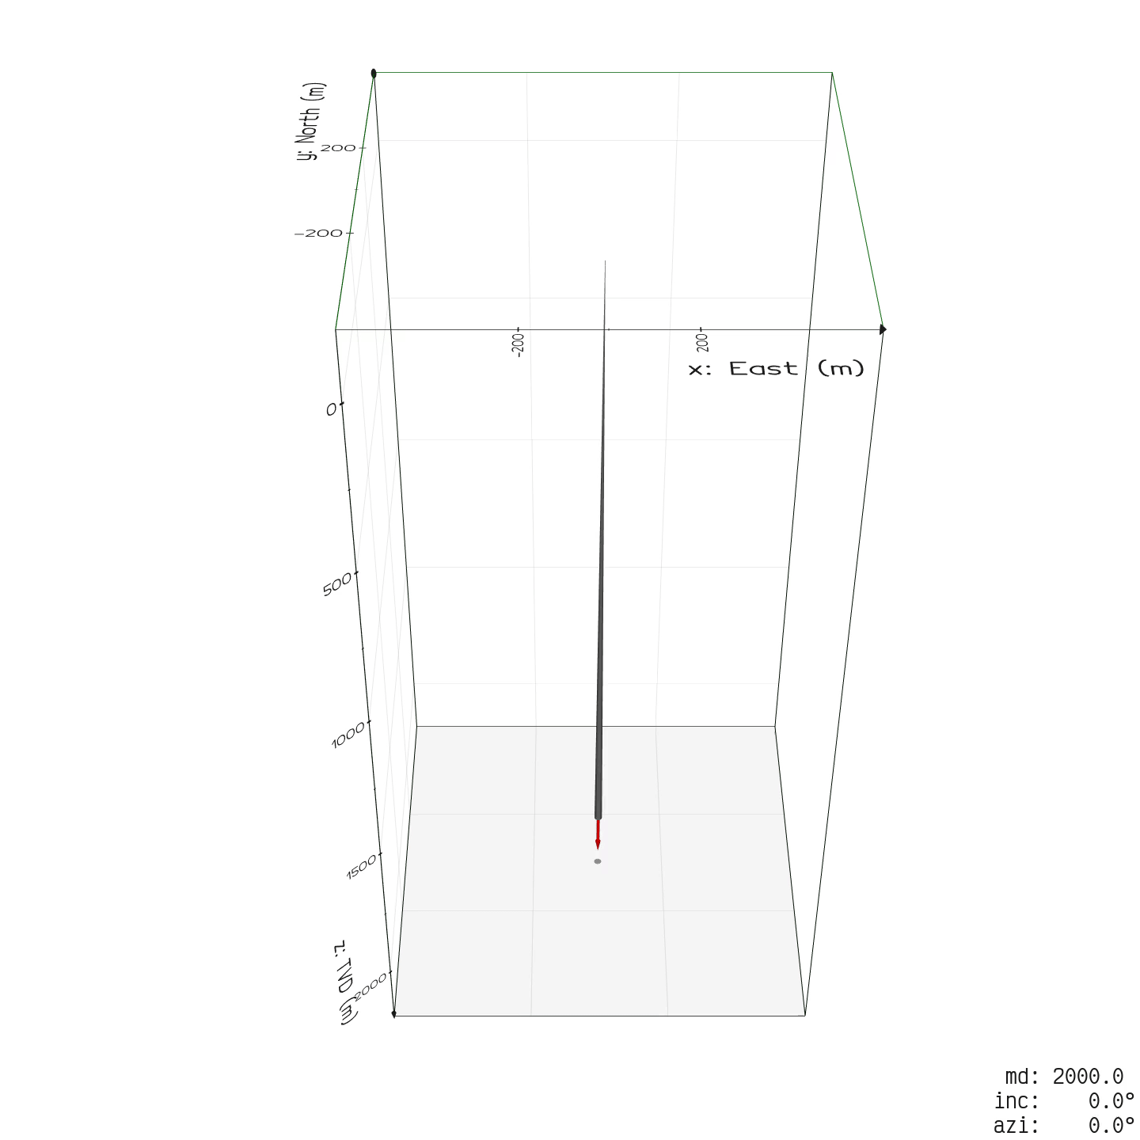
Since leaving Shell...
Learnt how to program in Python.
Co-founded White Space Energy and coded an automated well trajectory planner back-end.
Coded a density log to Pore Pressure and Fracture Pressure prognosis script in Python (for modeling large reservoir pressure depletion).
Coded a probabilistic (Wells) time and cost estimator using network graphs.
Coded, published and continue to develop and maintain the open source welleng Python library.
Developed a new method for Wells collision detection and avoidance using mesh collision detection developed for the robotics industry.

Slide 3
Problem Definition
From EBN’s webpage: “The storage of energy is another challenge that is part of the transition to a sustainable energy system. There are peaks and troughs to supply and demand of energy”.
An increasing number of highly skilled and hardworking people are being made redundant with the decline of the oil and gas industry.
Experience and knowledge of how to safely and efficiently drill wells is being lost as knowledge transfer from senior to junior staff is being curtailed.
Highly specialized equipment for drilling and maintaining wells is becoming increasingly redundant, with perfectly functional equipment being scrapped that could instead be utilised productively.
Also applicable to Geothermal Wells

Slide 4
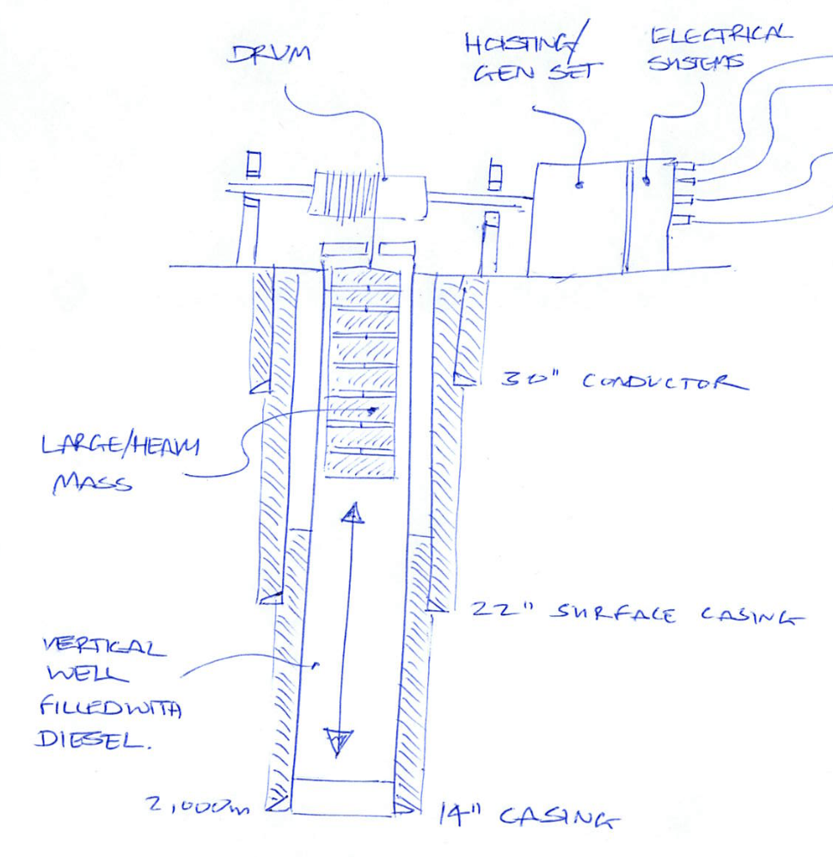
Well Gravity Battery Concept
Address the energy storage problem:
Repurpose existing wells (or roll-over geothermal exploration wells) as energy stores for relatively low cost and further deferment of ABEX.
Drilling new wells for energy storage close to or on the site of existing or planned solar and/or wind generation locations, deferring the requirement for energy distribution system upgrades.
Address the skills and equipment problems:
Redeploy skilled people and specialist equipment for the purpose of energy storage in Well Gravity Batteries.

Slide 5
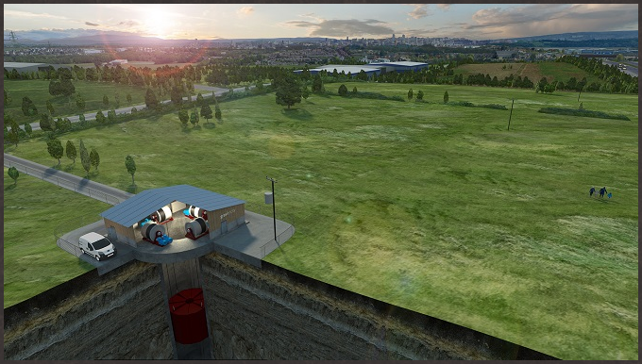
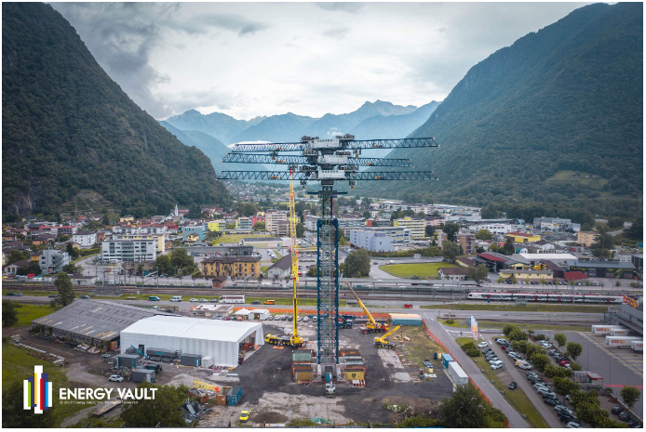
Feasibility
The concept of storing mechanical potential energy is neither novel or new, but to date has not been commercialized.
Gravitricity, working in collaboration with the Dutch company Huisman are currently trialing a 250kW Concept Demonstrator:
Concept deploys a large diameter shaft/bore, either repurposing abandoned mine shafts or boring new shafts.
During excess energy production periods, a mass is hoisted to surface and during low periods is allowed to descend at a controlled speed, converting potential to electrical energy.
Large diameter combined with long depths means that this concept can produce a large amount of energy (targeting 1 to 20 MW) almost immediately.
Energy Vault have prototyped a crane based, above ground gravity tower concept:
During period of excess energy production, towers of concrete blocks are constructed around the crane.
During low energy production periods, the blocks are deconstructed, converting potential mechanical energy to electrical energy.

Slide 6
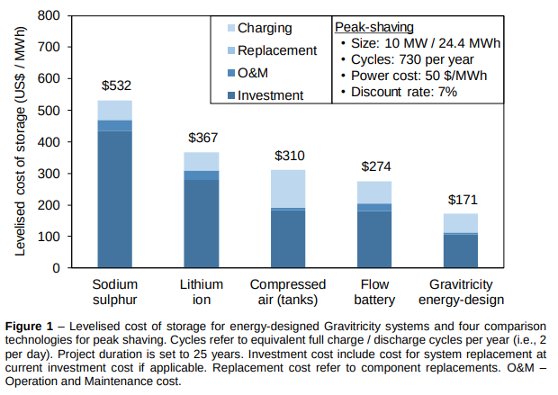
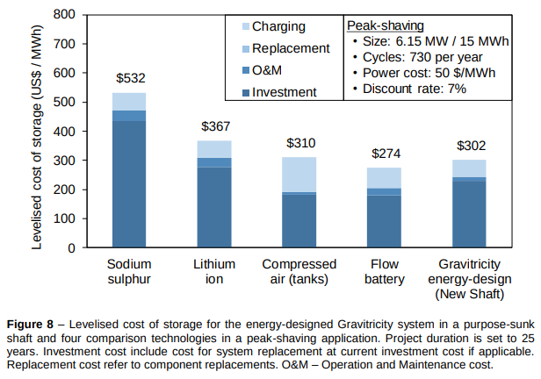
Gravitricity
Robust design that should be efficient and safe to operate.
Economics indicate very competitive concept with Levelised Cost of Storage (LCOS) around US$150/MWh repurposing an existing mineshaft (based on study by Imperial College London Consultants, March 2019).
Limited number of suitable/available shafts (especially in the Netherlands).
Location of existing shafts not geographically optimal (remote from energy production requiring reliance on electricity grid (not factored into unitised cost)).
Economics are less attractive when carrying the cost of a new shaft at US$300/MWh.
Uncertainty for cost of drilling a new shaft - requires specialised equipment and a suitable environment.
Approvals, permitting etc for drilling a deep shaft may be burdensome.
Note: abandonment costs are assumed zero!
How would a Gravity Well compare?

Slide 7
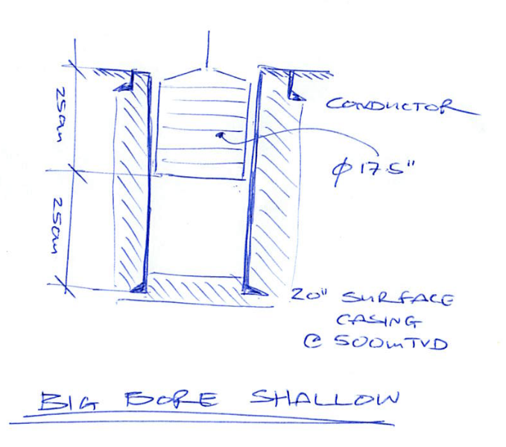
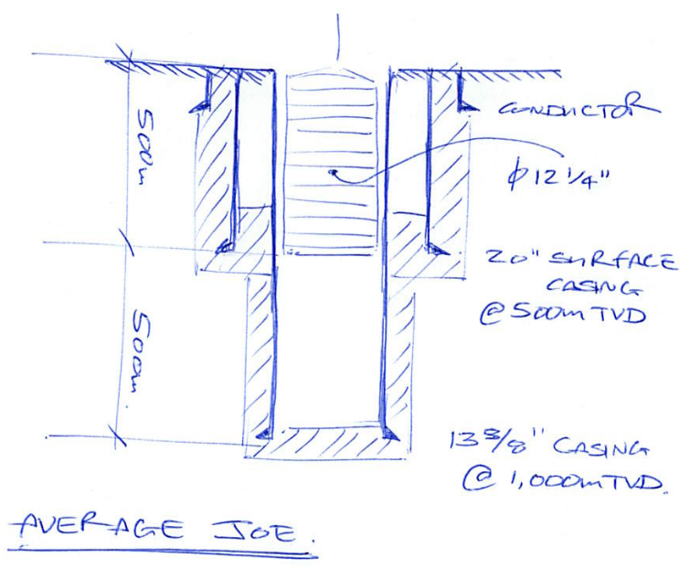
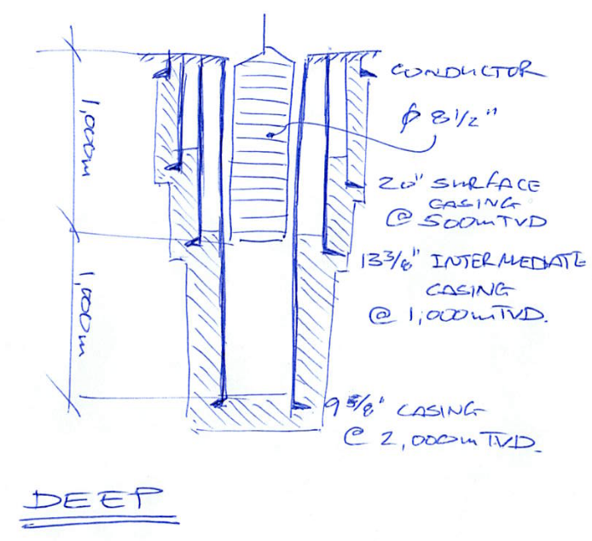
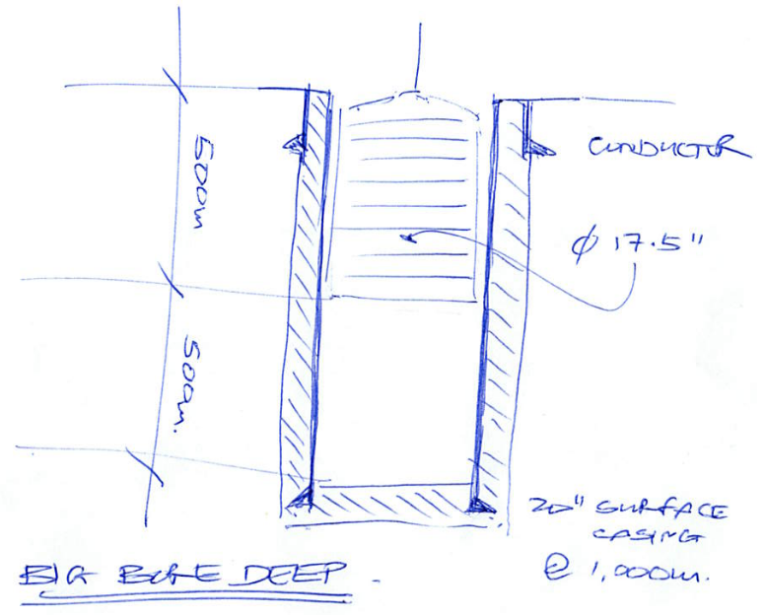
Peak power based on 2.5 hour discharge rate
Scenarios
Scenario | Peak Power MW | Capacity MWh
Big Bore Shallow | 0.07 | 0.18
Average Joe | 0.14 | 0.36
Deep | 0.27 | 0.69
Big Bore Deep | 0.29 | 0.73
Capacity of Gravitricity/Huisman trial equipment is 250 kW

Slide 8
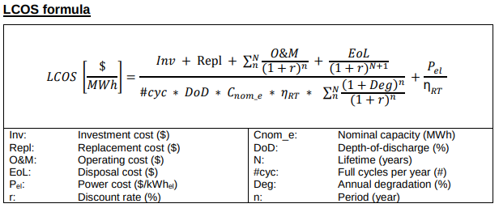
Levelized Cost Of Storage (LCOS):
params = {
'G': 9.81,
'density': 7800. - 830., # assume well diesel filled and take net density kg/m3
'costs': {
'casing_20': 800., # $/m
'casing_13': 400., # $/m
'casing_9': 250., # $/m
'steel': 650., # $/tonne
'rig_rate': 40_000., # $/day
'location_construction': 100_000., # cemented, run-off collection, cellar
'surface_equipment': 100_000., # winch, variable speed drive and switch gear
'replacement': 40_000., # cost of replacing variable speed drive after 25 years
# 'replacement': 0., # if life of VSD is 25 years and lifetime is 25 years
'operating': 10_000., # estimate of annual operating cost
'disposal': 100_000., # abandon well and location
'power': 50., # $/MWh taken from report $/MWh
},
'depth_of_discharge': 1., # able to utilise all stored energy
'discount_rate': 0.07,
'lifetime': 25, # years
'cycles_per_year': 730, # same assumption as report
'annual_degredation': 0., # it's mechanical so assume no degredation
'round_trip_efficiency': 0.85, # same assumptions as report
'peak_power_duration': 2.5, # same assumption as report
}
Formula and method taken from Imperial College London Consultants report
Utilized consistent input parameters (e.g. depth of discharge, cycles, lifetime) as Gravitricity input for a apples to apples comparison.
Coded up the formula in Python to allow for easy scaling of results

Slide 9
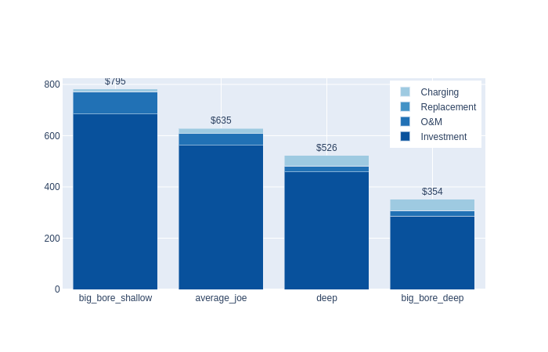
LCOS: Drilling a New Well
The deep big bore concept shows potential as a competitive solution for energy storage:
Surface casing depths of 800 m observed in NAM offset wells - a feasible concept
Intuitively, it makes sense that a big bore well is more effective:
Power output is proportional to mass
Mass is proportional to the square of the well diameter
Potential for cost reduction through scaling (multiple wells from a single pad)

Slide 10
Repurpose Existing Wells:
Many wells (especially in the Netherlands) are being or are scheduled to be abandoned.
Repurposing suitable wells has the potential to reduce the investment cost for energy storage.
Deferment of abandonments has the potential to reduce ABEX as abandonment experience and efficiency continues to improve with time.
Re-run the scenarios with reduced installation time, without the costs for OCTGs (as these are already installed).
params = {
'G': 9.81,
'density': 7800. - 830., # assume well diesel filled and take net density kg/m3
'costs': {
'casing_20': 0., # $/m
'casing_13': 0., # $/m
'casing_9': 0., # $/m
'steel': 650., # $/tonne
'rig_rate': 40_000., # $/day
'location_construction': 100_000., # cemented, run-off collection, cellar
'surface_equipment': 100_000., # winch, variable speed drive and switch gear
# 'replacement': 40_000., # cost of replacing variable speed drive after 25 years
'replacement': 0., # if life of VSD is 25 years and lifetime is 25 years
'operating': 10_000., # estimate of annual operating cost
'disposal': 100_000., # abandon well and location
'power': 50., # $/MWh taken from report $/MWh
},
'depth_of_discharge': 1., # able to utilise all stored energy
'discount_rate': 0.07,
'lifetime': 25, # years
'cycles_per_year': 730, # same assumption as report
'annual_degredation': 0., # it's mechanical so assume no degredation
'round_trip_efficiency': 0.85, # same assumptions as report
'peak_power_duration': 2.5, # same assumption as report
}

Slide 11
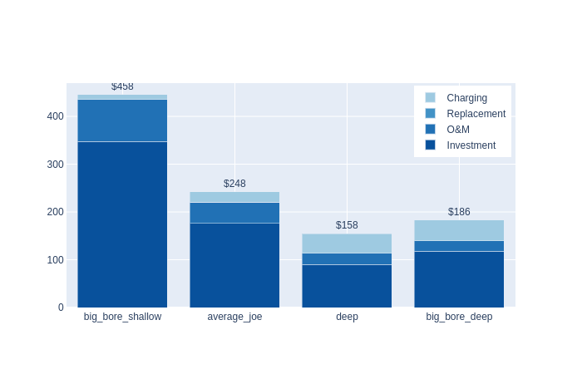
LCOS: Repurposing an Existing Well
Repurposing a vertical well offers potential as a competitive concept for energy storage as a gravity battery.
Assumes that removal of existing completion and abandonment of reservoir is carried as ABEX

Slide 12
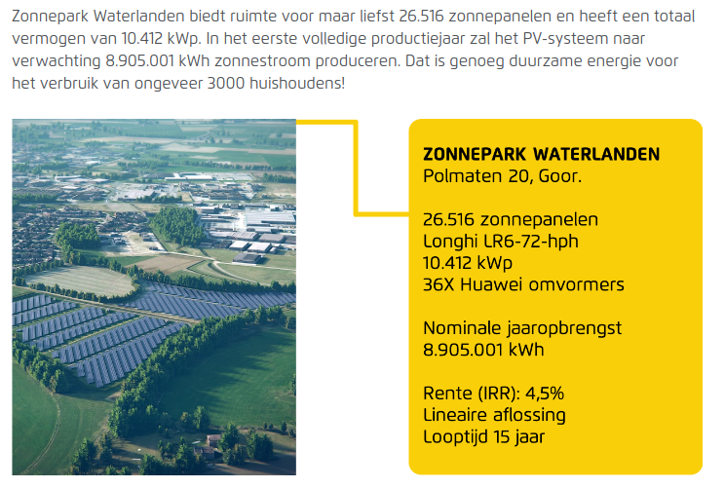
Context
A decent sized solar farm in NL generates on average 24 MWh/day.
Assume we allocate one third of production to storage - required capacity is 8 MWh.
Number of gravity wells required is:
8 MWh / 0.7 MWh = 12 wells
Investment cost for storage:
12 * USMM 1.6 = USDMM 20.0
Storage cost >> generating cost
There are advantages to having multiple wells:
Redundancy in event of a well going down or requiring an intervention or maintenance
Operate wells sequentially at optimal output/efficiency

Slide 13
Summary
High level economics indicate that repurposing of existing wells as gravity batteries could be a competitive and environmentally friendly solution to the ongoing energy storage problems associated with renewable energy (specifically solar).
Drilling new wells for the function of gravity batteries is less competitive, but there’s scope to improve the economics if a deep (>= 1,000 mTVD) big-bore (>= 17 ½” inner diameter) can be matured and implemented.

